Slide 1
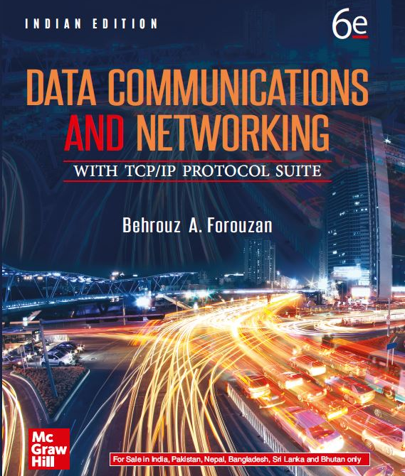
Chapter 06
Connecting Devices And Virtual LANs
Data Communications and Networking, With TCP/IP protocol suite Sixth Edition
Behrouz A. Forouzan
© 2022 McGraw Hill, LLC. All rights reserved. Authorized only for instructor use in the classroom.
No reproduction or further distribution permitted without the prior written consent of McGraw Hill, LLC.

Slide 2
Chapter 6: Outline
6.1 Connecting Devices
6.2 Virtual LANS

Slide 3
6-1 CONNECTING DEVICES
Hosts and networks do not normally operate in isolation. We use connecting devices to connect hosts together to make a network or to connect networks together to make an internet. Connecting devices can operate in different layers of the Internet model. We discuss three kinds of connecting devices: hubs, link-layer switches, and routers.

Slide 4
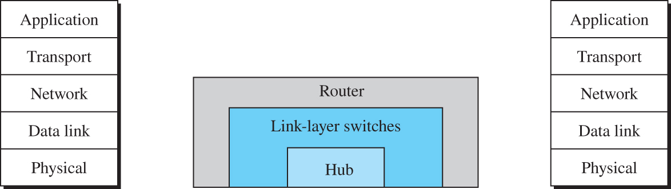
Figure 6.1 Three categories of connecting devices
Access the text alternative for slide images.

Slide 5
6.1.1 Hubs
A hub is a device that operates only in the physical layer. Signals that carry information within a network can travel a fixed distance before attenuation endangers the integrity of the data. A repeater receives a signal and, before it becomes too weak or corrupted, regenerates and retimes the original bit pattern.

Slide 6
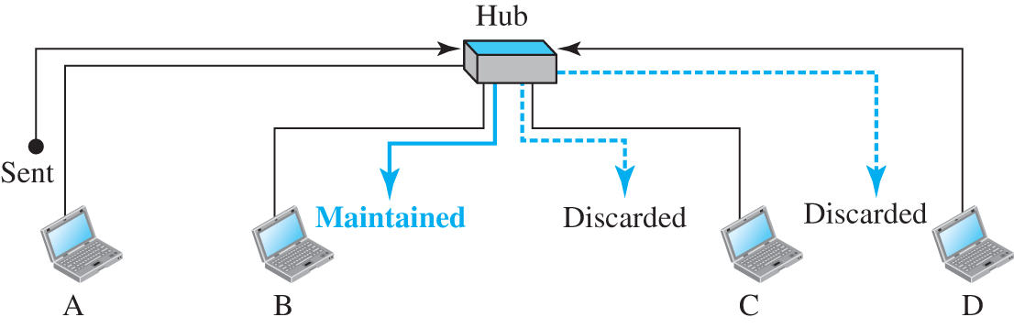
Figure 6.2 A hub
Access the text alternative for slide images.

Slide 7
6.1.2 Link-Layer Switches
A link-layer switch (or switch) operates in both the physical and the data-link layers. As a physical-layer device, it regenerates the signal it receives. As a link-layer device, the link-layer switch can check the MAC addresses (source and destination) contained
in the frame.

Slide 8
Filtering
One may ask what is the difference in functionality between a link-layer switch and a hub. A link-layer switch has filtering capability. It can check the destination link-layer address of a frame and can decide from which outgoing port the frame should be sent.

Slide 9
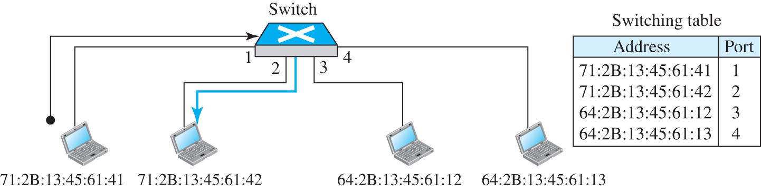
Figure 6.3 Link-layer switch
Access the text alternative for slide images.

Slide 10
Transparent Switches
A transparent switch is a switch in which the stations are completely unaware of the switch’s existence. If a switch is added or deleted from the system, reconfiguration of the stations is unnecessary.

Slide 11
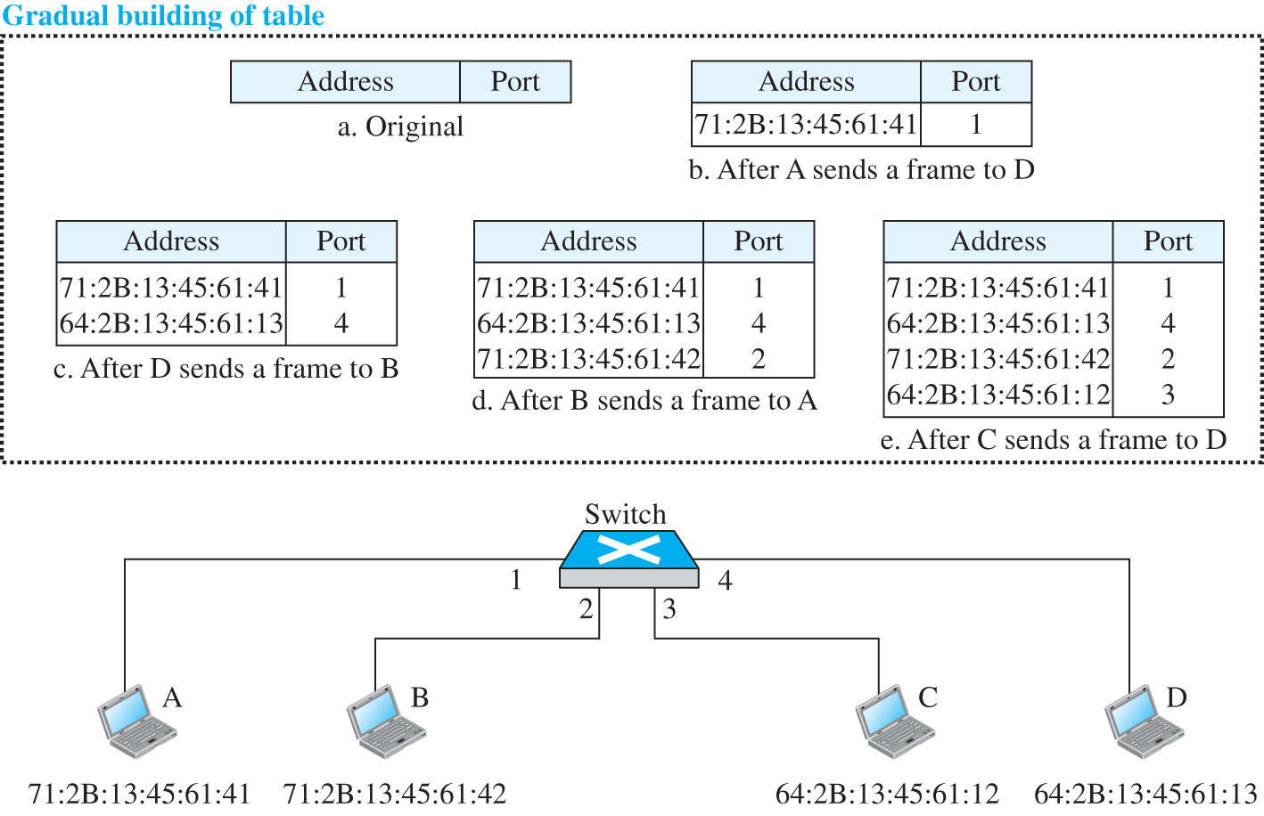
Figure 6.4 Learning switch
Access the text alternative for slide images.

Slide 12
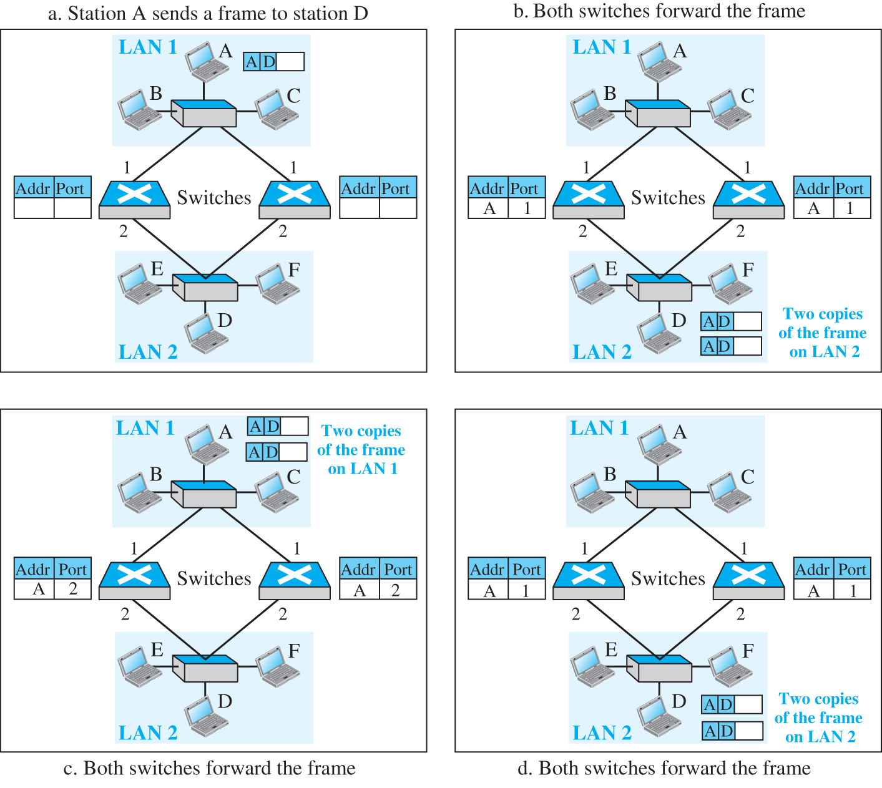
Figure 6.5 Loop problem in a learning switch (Part a)
a. Station A sends a frame to station D
Access the text alternative for slide images.

Slide 13
Figure 6.5 Loop problem in a learning switch (Part b)
b. Both switches forward the frame
Access the text alternative for slide images.

Slide 14
Figure 6.5 Loop problem in a learning switch (Part c)
c. Both switches forward the frame
Access the text alternative for slide images.

Slide 15
Figure 6.5 Loop problem in a learning switch (Part d)
d. Both switches forward the frame
Access the text alternative for slide images.

Slide 16
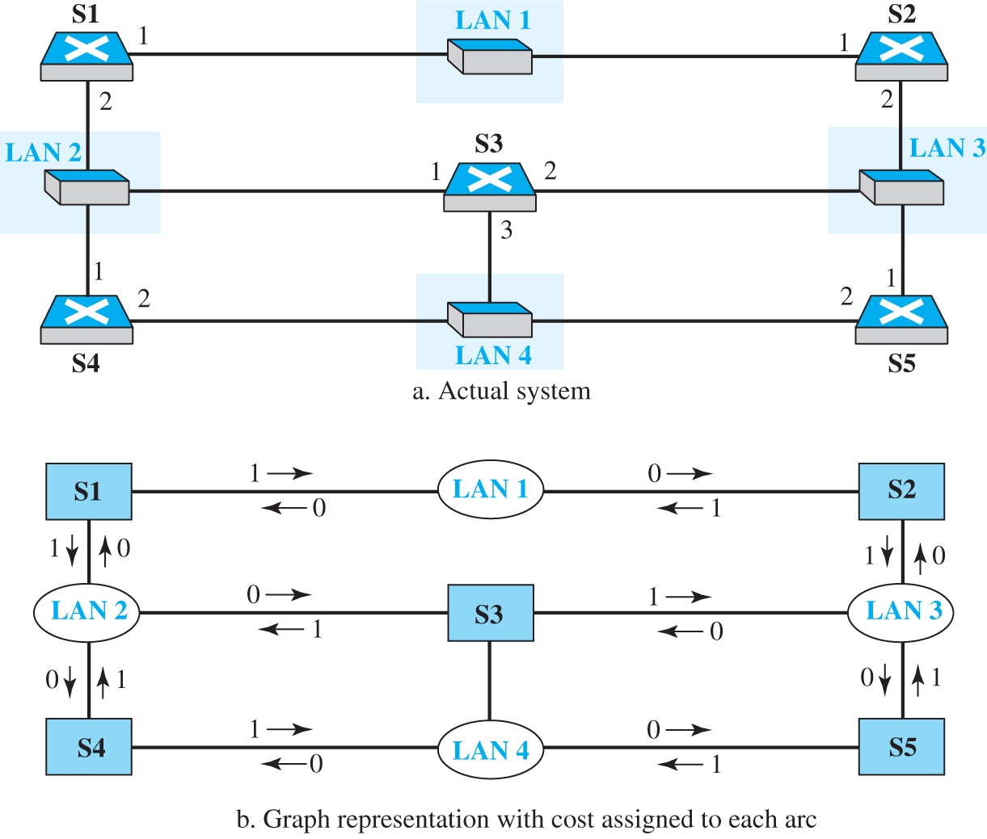
Figure 6.6 A system of connected LANs and its graph (Part a)
Access the text alternative for slide images.

Slide 17
Figure 6.6 A system of connected LANs and its graph (Part b)
Access the text alternative for slide images.

Slide 18
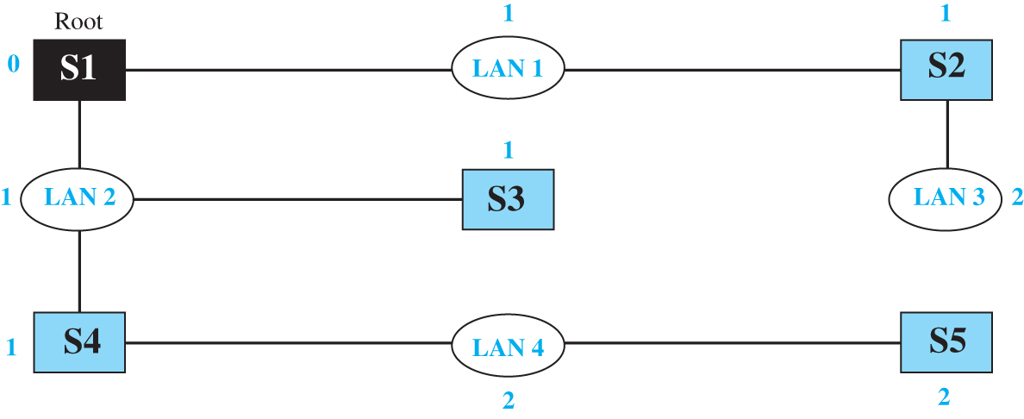
Figure 6.7 Finding the shortest path and the spanning tree for a switch.
Access the text alternative for slide images.

Slide 19
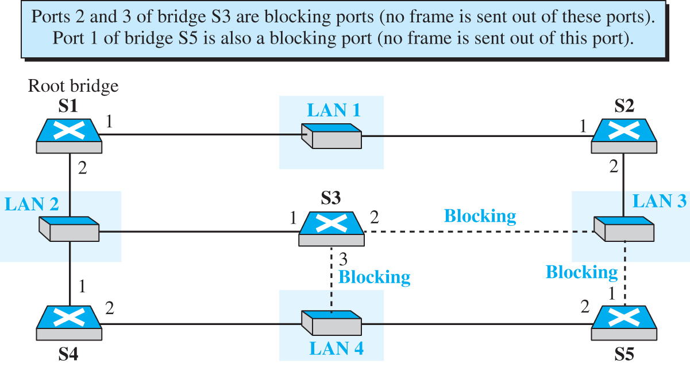
Figure 6.8 Forwarding and blocking ports after using spanning tree algorithm
Access the text alternative for slide images.

Slide 20
Advantages of Switches
A link-layer switch has several advantages over a hub. We discuss only two of them here: collision elimination and connecting heterogenous routers.

Slide 21
6.1.3 Routers
We will discuss routing in a future chapter when we discuss the network layer. In this section, we mention routers to compare them with a two-layer switch and a hub. A router is a three-layer device; it operates in the physical, data-link, and network layers.

Slide 22
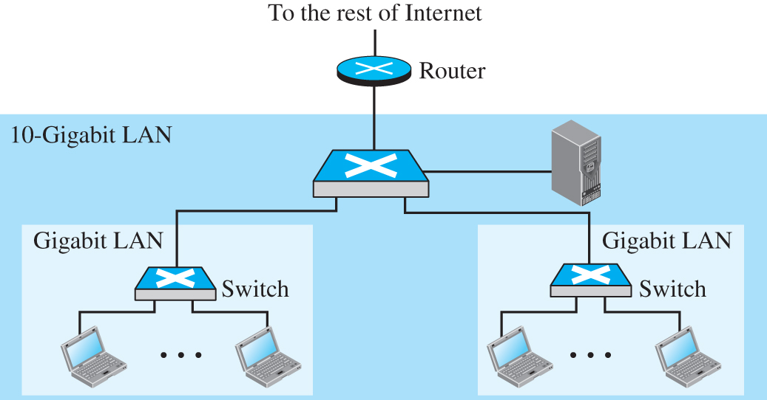
Figure 6.9 Routing example
Access the text alternative for slide images.

Slide 23
6-2 VIRTUAL LANS
A station is considered part of a LAN if it physically belongs to that LAN. The criterion of membership is geographic. What happens if we need a virtual connection between two stations belonging to two different physical LANs? We can roughly define a virtual local area network (VLAN) as a local area network configured by software, not by physical wiring.

Slide 24
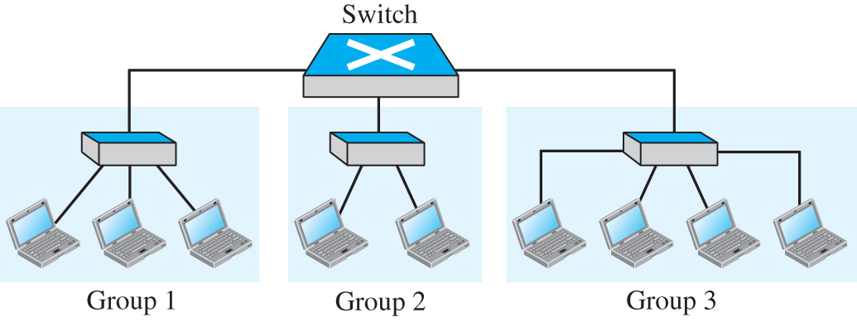
Figure 6.10 A switch connecting three LANs

Slide 25
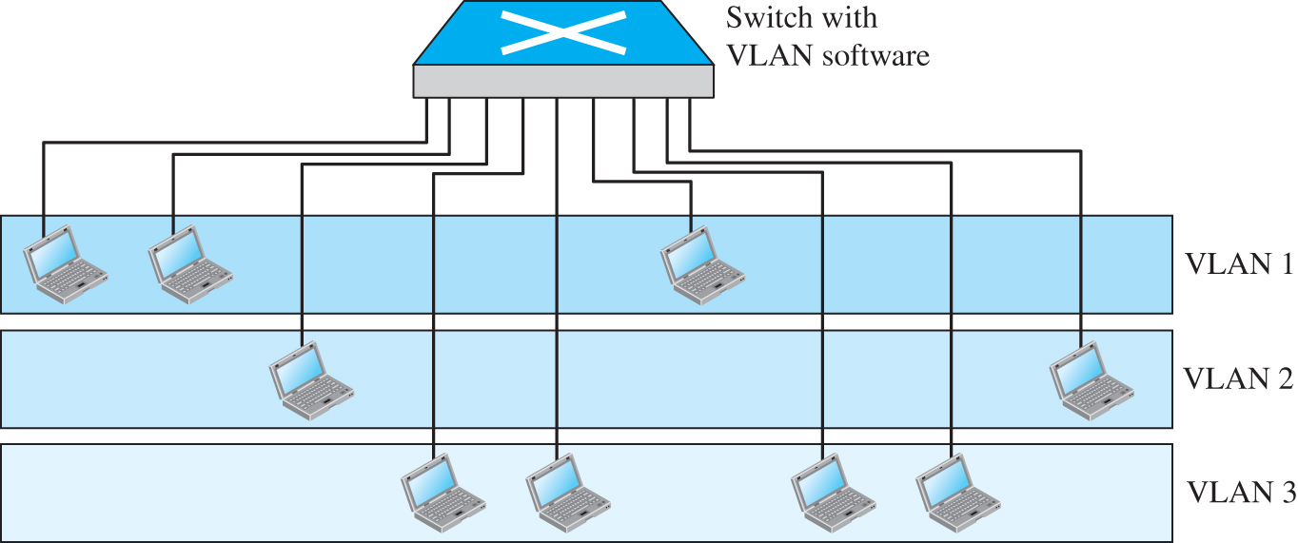
Figure 6.11 A switch using VLAN software
Access the text alternative for slide images.

Slide 26
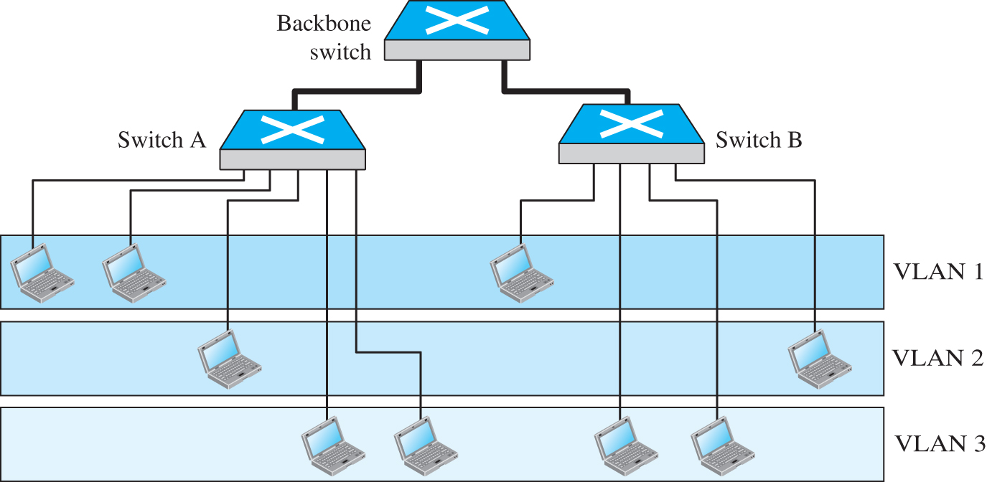
Figure 6.12 Two switches in a backbone using VLAN software
Access the text alternative for slide images.

Slide 27
6.2.1 Membership
What characteristic can be used to group stations in a VLAN? Vendors use different characteristics such as interface numbers, port numbers, MAC addresses, IP addresses, IP multicast addresses, or a combination of two or more of these.

Slide 28
Interface Numbers
Some VLAN vendors use switch interface numbers as a membership characteristic. For example, the administrator can define that stations connecting to ports 1, 2, 3, and 7 belong to VLAN 1; stations connecting to ports 4, 10, and 12 belong to VLAN 2; and so on.

Slide 29
MAC Addresses
Some VLAN vendors use the 48-bit MAC address as a membership characteristic. For example, the administrator can stipulate that stations having MAC addresses E2:13:42:A1:23:34 and F2:A1:23:BC:D3:41 belong to VLAN 1

Slide 30
Combination
Recently, the software available from some vendors allows all these characteristics to be combined. The administrator can choose one or more characteristics when installing the software. In addition, the software can be reconfigured to change the settings.

Slide 31
6.2.2 Configuration
How are the stations grouped into different VLANs? Stations are configured in one of three ways: manually, semiautomatically, and automatically.

Slide 32
Manual Configuration
In a manual configuration, the network administrator uses the VLAN software to manually assign the stations into different VLANs at setup. Later migration from one VLAN to another is also done manually. Note that this is not a physical configuration; it is a logical configuration. The term manually here means that the administrator types the port numbers, the IP addresses, or other characteristics, using the VLAN software.

Slide 33
Automatic Configuration
In an automatic configuration, the stations are automatically connected or disconnected from a VLAN using criteria defined by the administrator. For example, the administrator can define the project number as the criterion for being a member of a group. When a user changes projects, he or she automatically migrates to a new VLAN.

Slide 34
Semiautomatic Configuration
A semiautomatic configuration is somewhere between a manual configuration and an automatic configuration. Usually, the initializing is done manually, with migrations done automatically.

Slide 35
6.2.3 Communication between Switches
In a multi-switched backbone, each switch must know not only which station belongs to which VLAN, but also the membership of stations connected to other switches. Three methods have been devised for this purpose: table maintenance, frame tagging, and time-division multiplexing.

Slide 36
Table Maintenance
In this method, when a station sends a broadcast frame to its group members, the switch creates an entry in a table and records station membership. The switches send their tables to one another periodically for updating.

Slide 37
Frame Tagging
In this method, when a frame is traveling between switches, an extra header is added to the MAC frame to define the destination VLAN. The frame tag is used by the receiving switches to determine the VLANs to be receiving the broadcast message.

Slide 38
Time-Division Multiplexing (TDM)
In this method, the connection (trunk) between switches is divided into time-shared channels (such as TDM). For example, if the total number of VLANs in a backbone is five, each trunk is divided into five channels. The traffic destined for VLAN 1 travels in channel 1, the traffic destined for VLAN 2 travels in channel 2, and so on. The receiving switch determines the destination VLAN by checking the channel from which the frame arrived.

Slide 39
IEEE Standard
In 1996, the IEEE 802.1 subcommittee passed a standard called 802.1Q that defines the format for frame tagging. The standard also defines the format to be used in multi-switched backbones and enables the use of multivendor equipment in VLANs. IEEE 802.1Q has opened the way for further standardization in other issues related to VLANs. Most vendors have already accepted the standard.

Slide 40
6.2.4 Advantages
There are several advantages to using VLANs:
Cost and time reduction
Creating virtual work groups
Security

Slide 41
Cost and Time Reduction
VLANs can reduce the migration cost of stations going from one group to another. Physical reconfiguration takes time and is costly. Instead of physically moving one station to another segment or even to another switch, it is much easier and quicker to move it by using software.

Slide 42
Creating Virtual Work Groups
VLANs can be used to create virtual work groups. For example, in a campus environment, professors working on the same project can send broadcast messages to one another without the necessity of belonging to the same department. This can reduce traffic if the multicasting capability of IP was previously used.

Slide 43
Security
VLANs provide an extra measure of security. People belonging to the same group can send broadcast messages with the guaranteed assurance that users in other groups will not receive these messages.

Slide 44
End of Main Content
© 2022 McGraw Hill, LLC. All rights reserved. Authorized only for instructor use in the classroom.
No reproduction or further distribution permitted without the prior written consent of McGraw Hill, LLC.

Slide 45
Accessibility Content: Text Alternatives for Images

Slide 46
Figure 6.1 Three categories of connecting devices - Text Alternative
Return to parent-slide containing images.
A figure shows a hub, link-layer switches, and router present at the center. The five layers: Physical, Data-link, Network, Transport, and Application are present on both sides
Return to parent-slide containing images.

Slide 47
Figure 6.2 A hub - Text Alternative
Return to parent-slide containing images.
A hub connects to four host devices A, B, C, and D. A and D sent data to hub. The hub sent maintained message to B and discarded message to C and D.
Return to parent-slide containing images.

Slide 48
Figure 6.3 Link-layer switch - Text Alternative
Return to parent-slide containing images.
Four host devices connect to the four ports in a switch. The port 1 address is 71:2B:13:45:61:41, port 2 address is 71:2B:13:45:61:41, port 3 address is 64:2B:13:45:61:12 and port 4 address is 64:2B:13:45:61:13. A switching table lists the address and its port number.
Return to parent-slide containing images.

Slide 49
Figure 6.4 Learning switch - Text Alternative
Return to parent-slide containing images.
Four host devices A, B, C, and D connect to the four ports in a switch. The port 1 address is 71:2B:13:45:61:41, port 2 address is 71:2B:13:45:61:42, port 3 address is 64:2B:13:45:61:12 and port 4 address is 64:2B:13:45:61:13. Five switching tables with address and port are shown above. Table (a)- original represents address and port. Table (b) - after A sends a frame to D represents address 71:2B:13:45:61:41 and port 1. Table (c) - After D sends a frame to B represents address 71:2B:13:45:61:41 and port 1 and 64:2B:13:45:61:13 and port 4. Table (d) - after B sends a frame to A represents 71:2B:13:45:61:41 and port 1, 64:2B:13:45:61:13 and port 4, and 71:2B:13:45:61:42 and port 2. Table (e) - After C sends a frame to D represents 71:2B:13:45:61:41 and port 1, 64:2B:13:45:61:13 and port 4, 71:2B:13:45:61:42 and port 2 and 64:2B:13:45:61:12 and port 3.
Return to parent-slide containing images.

Slide 50
Figure 6.5 Loop problem in a learning switch (Part a) - Text Alternative
Return to parent-slide containing images.
Figure (a) shows Station A sends a frame to station D. L A N 1 includes systems A, B, and C connected to a station that connects to two switches with port numbers 1. L A N 2 has systems D E F connected to a station which connects to switches with port numbers 2.
Return to parent-slide containing images.

Slide 51
Figure 6.5 Loop problem in a learning switch (Part b) - Text Alternative
Return to parent-slide containing images.
Figure (b) shows Both switches forward the frame. Both switches connect with a station to two switches with address A and port numbers 1, L A N 2 includes systems D, E and F joined to station to controls with port numbers 2, where two copies of the frame on L A N 2.
Return to parent-slide containing images.

Slide 52
Figure 6.5 Loop problem in a learning switch (Part c) - Text Alternative
Return to parent-slide containing images.
Figure (c) shows Both switches forward the frame. Both switches forward the structure represents L A N 1 includes systems A, B, and C connected to the station to two buttons with numbers 1. L A N 2 with systems D E and F joined the station to two switches with numbers two and addressed A and port 2, where two copies of the frame on L A N 1.
Return to parent-slide containing images.

Slide 53
Figure 6.5 Loop problem in a learning switch (Part d) - Text Alternative
Return to parent-slide containing images.
Figure (d) shows Both switches forward the frame. Both switches connect with the station with two controls with numbers one and L A N 2 includes systems D E F connected to the station with two buttons with numbers with address A and port 1, where two copies of the frame on L A N 2.
Return to parent-slide containing images.

Slide 54
Figure 6.6 A system of connected LANs and its graph (Part a) - Text Alternative
Return to parent-slide containing images.
The figure (a) shows L A N 1 connected to two switches S1 and S 2, with numbers 1. S1 tied to L A N 2, S4 with numbers 2 and 1. S 2 associated with L A N 3, L A N 3 to S 5 with numbers 2 and 1. S 3 connected to L A N 2 with number 1, L A N 3 with number 2, and L A N 4 with number 3. S 4 associated with L A N 4, L A N 4 to S 5 with number 2.
Return to parent-slide containing images.

Slide 55
Figure 6.6 A system of connected LANs and its graph (Part b) - Text Alternative
Return to parent-slide containing images.
The figure (b) shows S1 is connected to L A N 1 and L A N 2 with 1. L A N 1 is connected to S 1 and S 2 with 0. S2 is connected to L A N 1 and L A N 3 with 1. L A N 2 is connected to S 1, S 3 and S 4 with 0. S3 is connected to L A N 2 and L A N 3 with 1 and directly connected with L A N 4. L A N 3 is connected to S 2, S 3 and S 5 with 0. S4 is connected to L A N 2 and L A N 4 with 1. L A N 4 is connected to S 4 and S 5 with 0. S5 is connected to L A N 3 and L A N 4 with 1.
Return to parent-slide containing images.

Slide 56
Figure 6.7 Finding the shortest path and the spanning tree for a switch. - Text Alternative
Return to parent-slide containing images.
In the illustration, Root S 1 with number 0 connects to L A N 1 with number 1 which connects to S 2 with number 1. S2 connects to L A N 3 with number 2. S 1 connects to L A N 2 with number 1 that connects to S 3 with number 1. L A N 2 connects to S 4 with number1 that connects to L A N 4 with number 2 and it connects to S 5 with number 2.
Return to parent-slide containing images.

Slide 57
Figure 6.8 Forwarding and blocking ports after using spanning tree algorithm - Text Alternative
Return to parent-slide containing images.
An illustration shows a connection from the port 1 of Root bridge S1 to L A N 1 and LAN 2. LAN 1 connects to port 1 of S2. Port 2 of S2 connects to LAN 3. LAN 2 connects to port 1 of S4 and port 1 of S3. Port 2 of S4 connects to LAN 4 which in turn connects to S5. The connection between port 3 of S3 and LAN 4, port 2 of S3 and LAN 3, and LAN 3 to port 1 of S5 are blocking.
Return to parent-slide containing images.

Slide 58
Figure 6.9 Routing example - Text Alternative
Return to parent-slide containing images.
A10 Gigabit L A N has a switch that connects to a server and to wo gigabit LANs. The Gigabit L A Ns has a switch connected to two systems. The router connects to the rest of internet.
Return to parent-slide containing images.

Slide 59
Figure 6.11 A switch using VLAN software - Text Alternative
Return to parent-slide containing images.
An illustration shows a switch with V L A N software connected to V L A N 1 with three systems, V L A N 2 with two systems, and V L A N 3 with four designs.
Return to parent-slide containing images.

Slide 60
Figure 6.12 Two switches in a backbone using VLAN software - Text Alternative
Return to parent-slide containing images.
An illustration shows a backbone switch connects to switch A and switch B. Switch A connects to two systems and switch B connects to one system in V L A N 1. Switch A connects to 1 system and switch B connects to 1 system in V L A N 2. Switch A connects to 2 systems and switch B connects to 2 systems in V L A N 3.
Return to parent-slide containing images.

